Slide 1
Common NFVI Telco Taskforce Introduction
25th Oct 2019

Slide 2


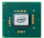












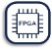
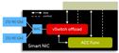

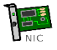


CNTT | Problem Statement
NF
NF
NF
Vendor A
NF
Vendor B
NF
Vendor C
NF
NF
NF
NF
Cloud native VNFs
Infrastructure Abstraction
Infrastructure Abstraction
(Common Shared Infrastructure)
Cloud stack A
NF
Cloud stack B
NF
NF
Cloud stack C
SmartNIC
Many combinations
=
silo deployments
✓ Reduced TCO
✓ Consistent Operating Model
✓ Better Utilized Infrastructure
✓ Scalable
✓ Easy to automate
✓ Unified Verification and Testing

Slide 3

































CNTT | Common NFVI Telco Task Force (CNTT)
SPONSORS

Slide 4
COMMON NFVI TELCO TASKFORCE (CNTT)
MISSION
Establish NFVI Reference Model, Architectures, & NFVI | VNF Verification Lifecycle to reduce cost, time to market, & complexity of Telco operations for the benefit of the broader community
4

Slide 5
COMMON NFVI TELCO TASKFORCE (CNTT)
VALUE STREAMS
GLOBAL NFVI LIFECYCLE FRAMEWORK
Establish an open-sourced end-to-end ecosystem to deliver, maintain & continually improve the infrastructure delivery lifecycle
Status: In-Progress
(Target Delivery - 4/30/20)
REFERENCE MODEL
REFERENCE ARCHITECTURE
REFERENCE IMPLEMENTATION
Develop a framework to drive continuity of Reference Architectures for NFVI
Design number of discrete NFVI specifications based on the Reference Model
Implement & deploy based on the design & configurations of each Reference Architecture
Status: Complete (Botrange – 9/19/19)
Status: Complete
(Botrange RA # 1 – 9/19/19)
Status: In-Progress
(Target Delivery – January 2020)
VERIFICATION & VALIDATION
Deliver compliant NFVI against a physical manifestation of Reference Architectures
Status: In-Progress
(Target Delivery – March 2020)
5

Slide 6




CNTT Overview
SPONSORSHIP
Reference Model hosted by GSMA
Reference Architectures (TBD)
Reference Implementations & VNF Verification hosted by OPNFV
Developed in an open source community ecosystem for a common NFVI
ORGANIZE around NFVI and VNF verifications & validations
COLLABORATE on CNTT processes and governance structure
RALLY around GSMA and Linux Foundation Communities
DRIVE compatibility and reusability of standards & reference solutions
OBJECTIVES
OUTCOMES
Single NFVI Reference Model and limited number of NFVI Reference Architectures & Implementations
Enhance OPNFV & CVC test ecosystem
Establish and sustain Global NFVI | VNF Certification Framework
~ 5 Reference Architectures
Reference Implementation & NVFI Verification
Process for continuous improvement
Reduced total cost to operationalize VNFs
Reduced overall time to market
INDUSTRY BENEFITS
Simplify hardware & network infrastructure operations
Lower VNF onboarding costs
Accelerate NFVI | VNF product innovation & time-to-market
Simplify development & deployment of NFV infrastructure
6

Slide 7


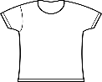



CNTT | Expected Outcome
OVP
VNF
Vendor
VNF
Compute flavour
Control
DP
DP
S
M
L
B
N
N
VNF-C
VNF-C
VNF-C
Instance type
Reference Architecture
NFVI Vendor
NFVI Vendor
Vendor B
NFVI Implementation
Vendor A
Reference Architecture
NFVI Implementation
Instances
Catalogue
Instance Type
Compute flavour
Reference Architecture
Reference Implementation
Reference Model
RM
Reference Architecture(s)
RA
NFVI Implementation
& RI
Reference Certification
RC

Slide 8









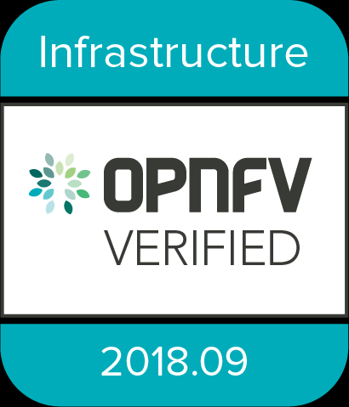

COMMON NFVI LIFECYCLE FRAMEWORK
Feedback for improvement of
Reference Model & Reference Architectures
Community Standards
Reference Model
External
Innovation
Feedback for improvement
Identified escaping defects for
Root Cause Analysis
Owner
TBD
RA 1
RA 2
RA 3
Ratified specifications for implementation
TELCO
OPERATORS
Reference Architectures
CNTT community defined
Reference Model & Reference Architectures
VNF
SUPPLIERS
RI 1
RI 2
Reference Implementations
OPNFV integrates
Reference Implementation with OVP testing ecosystem
SAMPLE NFVI STACK *
VNF1
VNF2
CNF3
NFVI Testing Lab
VNF Candidate
Download
tar.gz
result file
Upload
results file
to OVP Portal
VM
VM
VM
VM
C
C
Install Dovetail
Docker
Virtualization/Container Layer
(OS, KVM, VMWare, Kubernetes)
Management
Network
Test Host
DMZ
Server
Compute
Network
Storage
Firewall
Interface to public internet
Internet
SUT
OPNFV
Verified Program
OPNFV Verified VNF
Bare Metal Install
Common Node Setup
Ceph Setup
REF
NFVI
Install Data Path Network
OVP Testing Ecosystem
* For illustrative purposes only

Slide 9
CNTT | Relationship to other communities
EUAG
CVC
CNTT
TUG

Slide 10

RA2
3.0
CNTT | Roadmap
RA2
2.0
Reference Model
RA2
1.0
Reference Architecture
Released!
Reference Implementation
RI
1.0
RI
2.0
RI
3.0
Stable
RA1
1.0
RA1
2.0
RA1
3.0
RA1
3.x
Stable
RM
1.0
RM
2.0
RM
3.0
RM
3.x
RM
3.x
Stable
Botrange
TBD
TBD
TBD
Jun
Jul
Aug
Sep
Oct
Nov
Dec
Jan
Feb
Mar
Apr
May
Jun
Jul
Aug
2019
2020

Slide 11



CNTT | How to Contribute
https://github.com/cntt-n/CNTT
https://cntt-n.github.io/CNTT/
https://github.com/cntt-n/CNTT/wiki
Reference Model
RM
https://github.com/cntt-n/CNTT/tree/master/doc/ref_model
Reference Architecture
RA
https://github.com/cntt-n/CNTT/tree/master/doc/ref_arch
Reference Implementation
RI
https://github.com/cntt-n/CNTT/tree/master/doc/ref_impl
Reference Certification
RC
https://github.com/cntt-n/CNTT/tree/master/doc/ref_cert

